Slide 1

TRIBAL MEDICINE DATABASE
Submitted By:
M.Satya Dinesh-211801360005 K.Tejamai-211801360015
P.Hari Krishna-211801360006 P.Mythri-211801360010
M.Sai Krishna-211801360018 U.Bhargavi Reddy-211801360002
Under the esteemed guidance of:
Dr. Suman Polaki – AssociateProfessor
N.V.S. Shankar - Associate Professor
Department of Computer Science and Technology,
School of Engineering and Technology,
Centurion University of Technology and Management, Vizianagaram

Slide 2
ABSTRACT
The project focuses on documenting and preserving the rich traditional knowledge of medicinal plants used by tribes in Andhra Pradesh for treating various diseases. Through extensive research and data collection, the project compiles information on plant species, their medicinal properties, and the specific parts of plants used in traditional medicine practices.
The database developed as part of this project serves as a comprehensive repository of this valuable indigenous knowledge, facilitating easy access and retrieval of information for researchers, healthcare professionals, and the general public interested in herbal medicine.
The project's front-end interface, built using HTML, CSS, JavaScript, and React, provides a user-friendly experience for exploring the database, searching for specific plants or ailments, and accessing detailed information about medicinal uses, preparation methods, and cultural significance.
On the back end, PHP is utilized to manage database interactions, ensuring seamless data storage, retrieval, and update functionalities. Additionally, Google Sheets integration enhances collaboration and data management capabilities, allowing for real-time updates and shared access among project collaborators.
Overall, this project aims to promote the preservation of indigenous knowledge, support research in herbal medicine, and contribute to the development of sustainable healthcare practices by leveraging technology and traditional wisdom.

Slide 3
INTRODUCTION
In India, the use of different parts of several medicinal plants to cure specific ailments has been practiced since ancient times. Ehanobotanical studies were carried out to collect information on the use of medicinal plants by the tribal community who live in the forests of Andhra Pradesh, India.
It deals with the main 33 tribes of the Andhra Pradesh in india.
In addition by using the some papers as a reference we extracted the data of tribes and for which disease which plant is used to cure that and how they prepared that.
Most of the medicinal plants are taken in as roots, tubers, stem and leaves, are taken orally with or without combination of other plants, external applications like paste, fumigation. Most of plants used by them are Herbs (42%), shrubs (20%), Trees (33%).and Climbers (5%) The most striking feature of tribal life is their simplicity.
By leveraging modern technologies such as HTML, CSS, JavaScript, React, PHP, and Google Sheets, we are developing a robust platform that bridges the gap between traditional wisdom and contemporary healthcare needs. Our front-end interface provides intuitive access to a wealth of information, allowing users to explore the medicinal properties of specific plants, learn about traditional preparation methods, and discover the cultural significance associated with herbal remedies.
On the back end, our database management system ensures efficient storage, retrieval, and management of tribal data and medicinal plant information. The integration of Google Sheets enhances collaboration and data sharing among project collaborators, facilitating real-time updates and streamlined workflows.

Slide 4
EXISTING SYSTEM
Manual Processes: Time-Consuming: Manual data collection through field surveys, interviews, and documentation is labor-intensive and time-consuming.
Inefficient Data Retrieval: Without a centralized database, retrieving specific information can be cumbersome and time-consuming.
Duplication and Inconsistencies: Data duplication and inconsistencies can occur due to the lack of automated validation and data cleaning processes.

Slide 5
PROPOSED SYSTEM
This includes designing and implementing a structured database to store relevant data such as tribal community information, medicinal plant details, traditional medicine practices.
The system also involves creating a user-friendly front-end interface using technologies like HTML, CSS, JavaScript, and React to facilitate easy navigation, data visualization, and user interaction.
Additionally, a robust back-end system will be implemented using PHP or suitable technologies to handle database operations, user authentication, and data security.
Features like advanced search functions, data visualization tools, user feedback mechanisms, and collaborative tools integration (optional) will enhance the system's functionality.

Slide 6
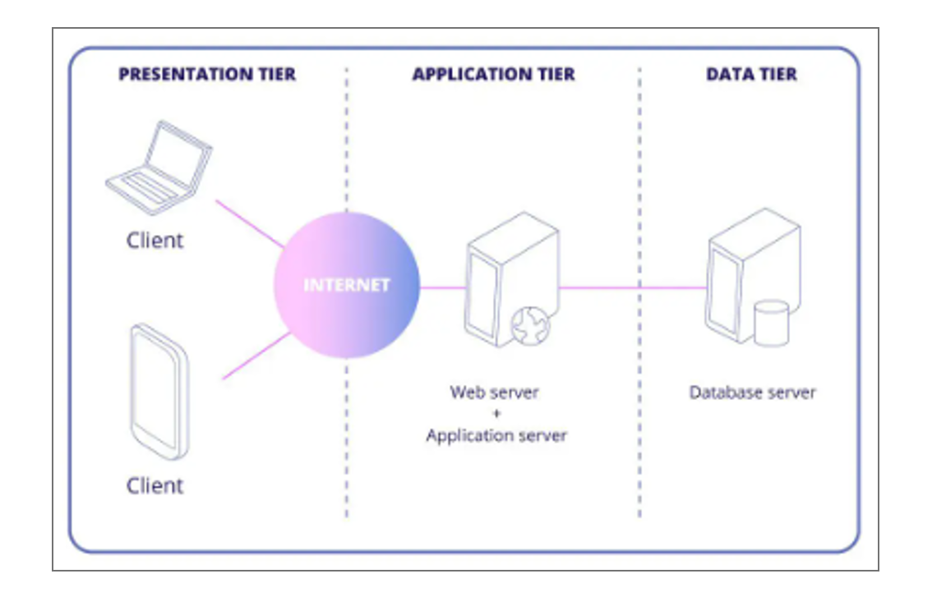
ARCHITECTURE

Slide 7
SOFTWARE REQUIREMENTS
Operating System
Web Server
Xampp
Client-side technologies:
HTML, CSS, JAVASCRIPT

Slide 8
HARDWARE REQUIREMENTS
Processor : intel’s core i3
Hard Drive: 32 GB or more
Memory (RAM): 4 GB or above
Operating system: windows 10,11

Slide 9
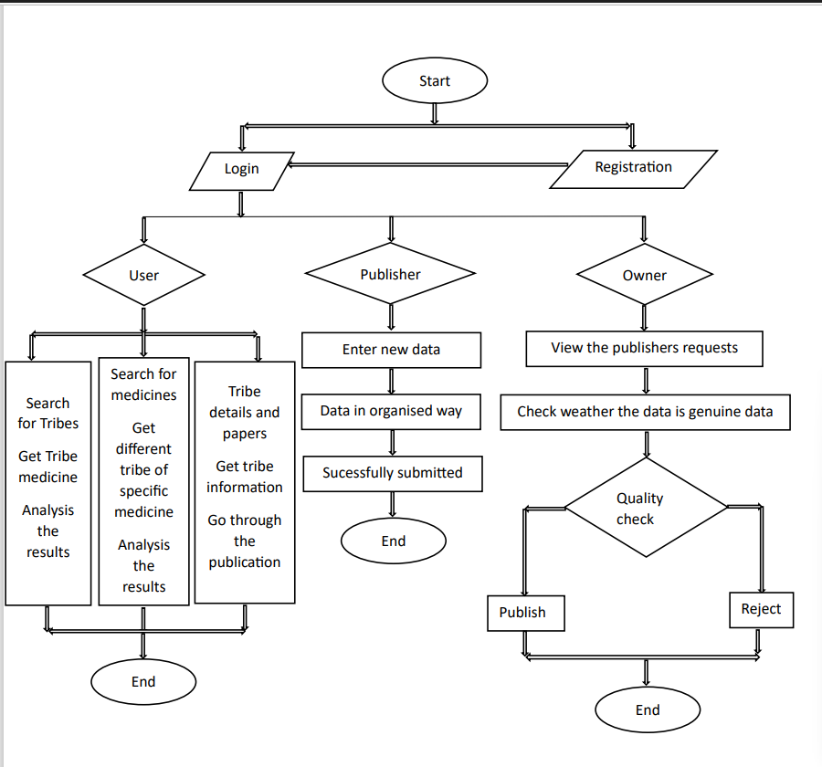
FLOW CHART

Slide 10
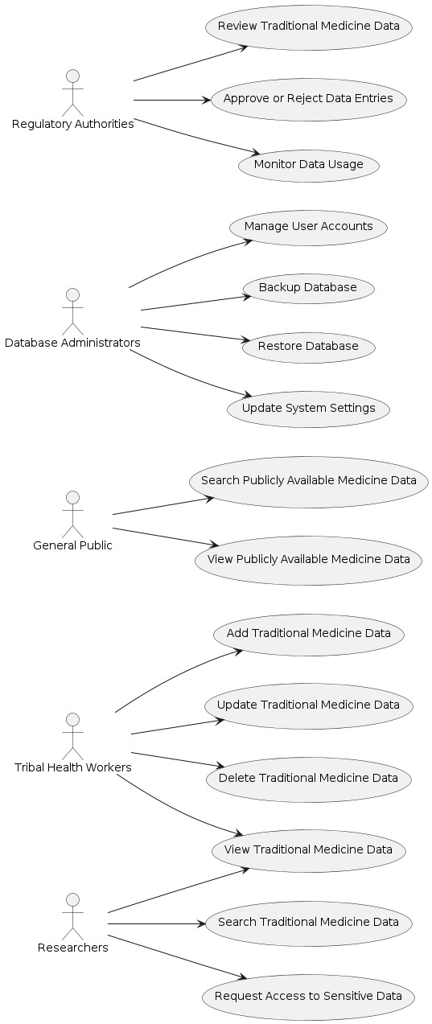
USE CASE DIAGRAM

Slide 11
METHODOLOGY
Literature Review and Data Compilation:
Review existing literature, research papers, and ethnobotanical surveys related to tribal medicine in Andhra Pradesh.
Compile data on medicinal plants, their therapeutic properties, preparation methods, and cultural significance.
Data Compilation and Organization:
Compile the gathered data into a structured format, categorizing information based on plant species, medicinal properties, cultural significance, and geographical distribution.
Organize the data systematically to facilitate easy retrieval, analysis, and presentation.
Database Development:
Develop a database system to store and manage the collected data effectively.
Design the database schema, including data fields, relationships, and indexing, to ensure efficient data storage and retrieval.

Slide 12
Front-end Interface Design:
Design a user-friendly front-end interface using HTML, CSS, JavaScript, and React.
Implement interactive features such as search, filter, and visualization tools to enhance user experience and facilitate data exploration.
Back-end System Implementation:
Implement back-end functionalities using PHP for database management, data retrieval, and user interactions.
Ensure data security, access controls, and backup mechanisms to protect and preserve the integrity of the collected data.
Quality Assurance and Documentation:
Conduct quality checks and validation processes to verify the accuracy and reliability of the collected data.
Document the research methodologies, data sources, validation procedures, and project outcomes for transparency and future reference.

Slide 13
DATABASE STRUCTURE
In this project there are totally 33 tables containing in the database.
Each table consisting of the data of the each tribe.
Each plant has a unique identifier (Plant ID) for easy reference.
Provides details such as the common name (Plant Name) and scientific classification (Scientific Name) of each plant.
Describes the plant's properties, uses, and cultural significance (Description).
Specifies which parts of the plant are used in traditional medicine (Parts Used).
Outlines methods of preparing the plant for medicinal use (Preparation Methods).
Lists the therapeutic properties associated with each plant (Therapeutic Properties).

Slide 14
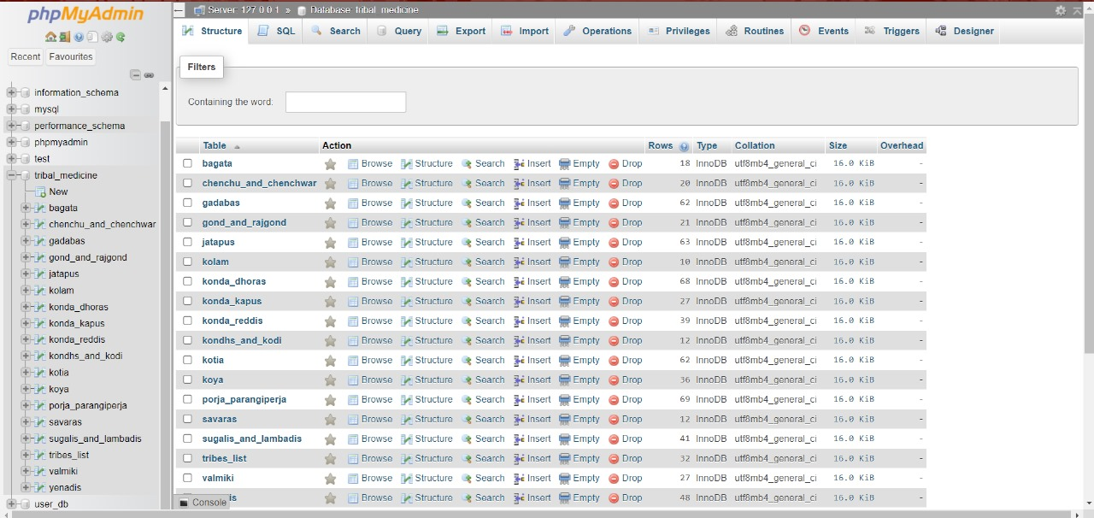
DATABASE STRUCTURE

Slide 15
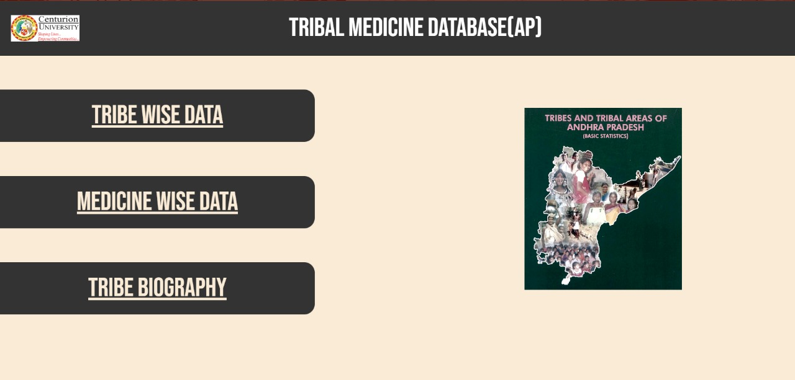
RESULTS

Slide 16
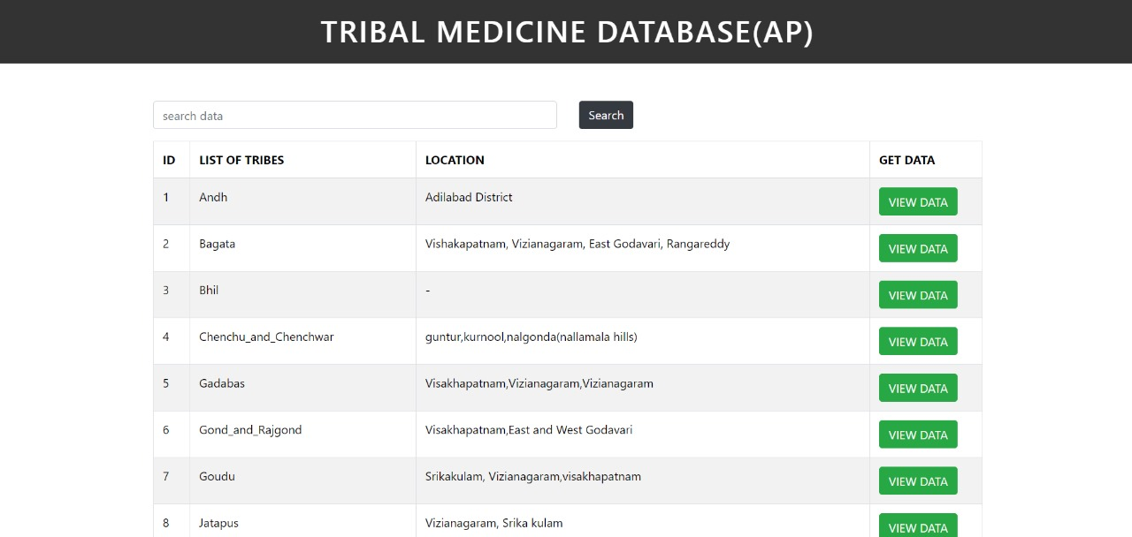
RESULTS

Slide 17
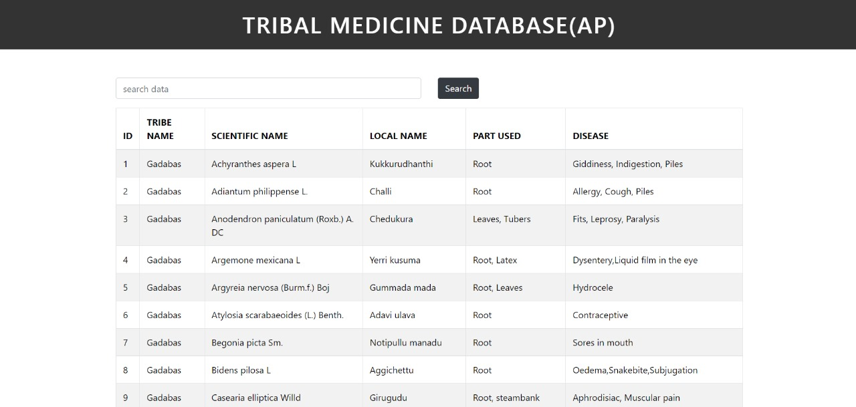
RESULTS

Slide 18
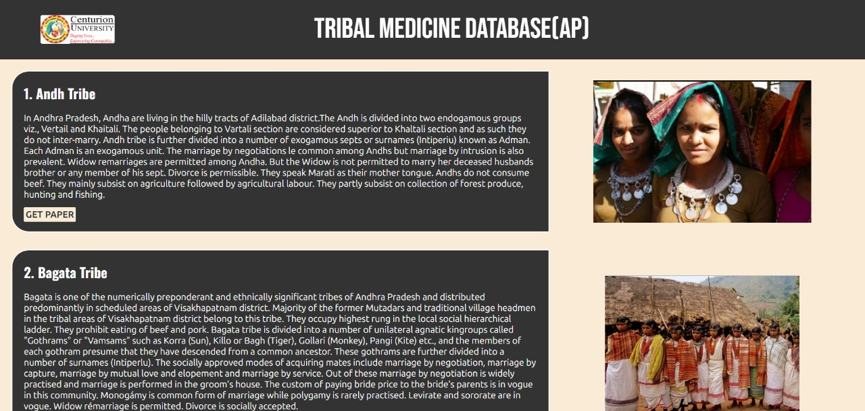
RESULTS

Slide 19
APPLICATIONS
Healthcare Research and Development
Cultural Preservation and Heritage Conservation
Educational and training programs
Public health initiatives
Ethnobotanical and environmental studies
Colloborative research

Slide 20
CONCLUSION
project serves as an educational resource, promoting awareness, education, and appreciation of traditional medicine and indigenous knowledge. Certainly! Integrating traditional medicine into modern healthcare means combining ancient healing practices with modern medical approaches. This integration is like having more tools in a toolbox to help people stay healthy and treat illnesses. Traditional remedies, like herbal medicines or healing rituals, are recognized for their effectiveness and safety.
They provide options that work alongside regular treatments, giving patients more choices based on what works best for them. This integration also brings different healthcare experts together—traditional healers, doctors, scientists, and policymakers—to share knowledge and ideas. It helps everyone understand and respect different ways of healing, leading to better healthcare options for everyone. Overall, it's about using the best of both worlds to create a more comprehensive and inclusive healthcare system that meets the diverse needs of patients.

Slide 21
THANK YOU

